Slide 1
Microsoft & Palo Alto Networks
Lab Session
Matt McLimans, Public Cloud Consultant Engineer

Slide 2
Agenda
Palo Alto Networks Platform Overview (15 minutes)
Best Practices for In-line security (15 Minutes)
Azure Technical Integrations (15 minutes)
Lab
Please ask any questions during the presentation!

Slide 3
Palo Alto Networks Platform

Slide 4








The Common Thread in Security Breaches
Same life cycle is followed across both physical or virtualized network
INFECT USER
MOVE
LATERALLY
STEAL
DATA
HARVEST BITCOIN
GAIN
FOOTHOLD
EXECUTE
GOAL
BUILD
BOTNETS

Slide 5



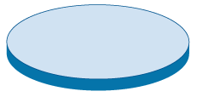









Countering Threats – Legacy Approach
DNS detection for outbound DNS
Internet
Enterprise network
APT detection for port 25 APTs
APT detection for port 80 APTs

Slide 6





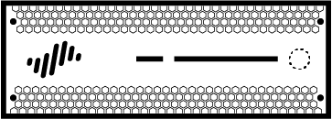



FIRST DISRUPTION
Threat Prevention
URL Filtering
WildFire
GlobalProtect
CLOUD-DELIVERED SECURITY SERVICES
ENDPOINT
NETWORK
CLOUD
NETWORK

Slide 7


Leadership in Cybersecurity
85
of Fortune 100
rely on Palo Alto Networks
#1
in Enterprise Security
54,000+
customers
in 150+ countries
Revenue trend
40% CAGR
FY14 - FY18
FY14
FY15
FY16
FY17
FY18
63% of the Global 2K
are Palo Alto Networks customers
29% year over year
revenue growth*
Q4FY2018. Fiscal year ends July 31.
Gartner, Market Share: Enterprise Network Equipment by Market Segment, Worldwide, 1Q18, 14 June 2018

Slide 8





SECOND DISRUPTION – SECURITY OPERATING PLATFORM
PALO ALTO NETWORKS APPS
3rd PARTY APPS
CUSTOMER APPS
APPLICATION FRAMEWORK
LOGGING SERVICE
THREAT INTEL DATA
ENDPOINT
NETWORK
CLOUD
NETWORK

Slide 9







CONSISTENT SECURITY
Physical network
IaaS
Mobile
SaaS
Private cloud
PaaS
9 | © 2018 Palo Alto Networks. All Rights Reserved.

Slide 10
CLOUD SECURITY
CUSTUMER PERSPECTIVE

Slide 11
SHARED RESPONSIBILITY MODEL
Customer content
Customers are responsible for their security IN the cloud
Platform, Applications, Identity & Access Management
Operating System, Network & Firewall Configuration
Encryption Key Management
Client & Server Encryption
Network Traffic Protection
Cloud Infrastructure & Services
Azure looks after security OF the cloud
Compute
Storage
Database
Networking

Slide 12


TRIVIA QUESTION!
Through 2020
95%
Of cloud security
failures will be the customer fault
“A Public Cloud Risk Model: Accepting Cloud Risk Is OK, Ignoring Cloud Risk Is Tragic,” Gartner, November 2, 2016

Slide 13
NATIVE PUBLIC CLOUD SECURITY
Port filtering and ACLs only
No application visibility
No threat prevention capability
Cannot see/control files
No data exfiltration protection
Security Groups
HTTP/Web apps only
Customized for every app
No application visibility across other ports
Limited threat prevention capability
No data exfiltration protection
Web Application Firewall

Slide 14
Our Prevention Philosophy
Complete
visibility
Reduce attack surface area
Prevent all known threats
Prevent
new threats
All applications
All users
All content
Encrypted traffic
SaaS
Public cloud
Mobile
Enable business apps
Block “bad” apps
Limit app functions
Limit file types
Block websites
Exploits
Malware
Command & control
Malicious websites
Bad domains
Stolen credentials
Dynamic analysis
Static analysis
Attack techniques
Anomaly detection
Analytics

Slide 15
slideshare-uploading
application function
PDF
file type
slideshare
application
roadmap.pdf
file name
344 KB
engineering
group
HTTP
protocol
computer-internet-info
URL category
msmith
user
SSL
protocol
canada
destination country
172.16.1.10
source IP
TCP/443
destination port
64.81.2.23
destination IP

Slide 16
slideshare-downloading
application function
EXE
file type
slideshare
application
shipment.exe
file name
344 KB
finance
group
HTTP
protocol
unknown
URL category
sjones
user
SSL
protocol
china
destination country
172.16.1.10
source IP
TCP/443
destination port
64.81.2.23
destination IP

Slide 17
OUR VISION FOR
PUBLIC CLOUD SECURITY

Slide 18





THREE FRONTS: API, HOST, INLINE
CLOUD APPLICATION
Continuous security & compliance
Platform-as-a-Service (PaaS)
API
OBJECT STORAGE
CACHING
DATABASE
Secure OS and app within workloads
Web Server
App Server
HOST
Protect and segment cloud workloads
WEB
APP
Infrastructure-as-a-Service (IaaS)
Inline

Slide 19



VM-SERIES: PROTECT AND SEGMENT CLOUD WORKLOADS
CLOUD APPLICATION
Platform-as-a-Service (PaaS)
OBJECT STORAGE
CACHING
DATABASE
Web Server
App Server
Protect and segment cloud workloads
WEB
APP
Infrastructure-as-a-Service (IaaS)
Inline
Prevent outbound and inbound attacks
Application visibility and workload segmentation
Centrally manage and automate deployments

Slide 20

EVIDENT: CLOUD SERVICES INFRASTRUCTURE PROTECTION
CLOUD APPLICATION
Continuous security & compliance
Platform-as-a-Service (PaaS)
API
OBJECT STORAGE
CACHING
DATABASE
Web Server
App Server
Protect and segment cloud workloads
WEB
APP
Infrastructure-as-a-Service (IaaS)
Inline

Slide 21

EVIDENT: CLOUD SERVICES INFRASTRUCTURE PROTECTION
CLOUD APPLICATION
Continuous security & compliance
Platform-as-a-Service (PaaS)
API
OBJECT STORAGE
CACHING
DATABASE
Secure OS and app within workloads
Web Server
App Server
HOST
Protect and segment cloud workloads
WEB
APP
Infrastructure-as-a-Service (IaaS)
Inline

Slide 22




WORKLOAD PROTECTION TRAPS
APP WORKLOAD
Traps Advanced Endpoint Protections
Multi-method
Attack Prevention
Lightweight Agent
Real-time Exploit and Malware Protection
Protects Unpatched Workloads

Slide 23










CLOUD-DELIVERED SECURITY SERVICES
URL Filtering
Threat Prevention
Malware
Analysis
Security
Center
3rd party feeds
MineMeld
Customer
data
CLOUD APPLICATION
Platform-as-a-Service (PaaS)
RL
OBJECT STORAGE
CACHING
DATABASE
API
Web Server
App Server
WEB
APP
Infrastructure-as-a-Service (IaaS)

Slide 24
DEPLOYMENT USE-CASES
& LICENSING

Slide 25







Deployment Use Cases
Protect your cloud deployment just as you would your data center
Hybrid | Segmentation | Internet Gateway | Remote Access
Securely deploy applications in your data center or in the cloud | Separate data and applications for compliance and security | Protect Internet facing applications | Security consistency for your network, your cloud, and your devices

Slide 26
Licensing Options
Bring Your Own License (BYOL)
Traditional purchase process
Pick the VM-Series, the subscriptions and support plan
Use auth code to deploy from Azure management console
Pay As You Go via Marketplace
Bundle 1: VM-300, Threat Prevention and Premium support
Bundle 2: VM-300, Threat Prevention, URLF, WildFire and Premium support
Hourly subscription purchased from Marketplace
VM-Series Enterprise License Agreement
Unlimited VM-Series consumption (BYOL)
Includes all subscriptions and Panorama
Single auth code can be used across all clouds
No true-up or clawback

Slide 27
AZURE COMPONENTS
& DEFAULT BEHAVIORS

Slide 28

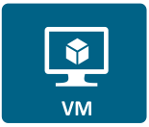
Virtual Network – Traffic Forwarding Default Behavior
All resources communicate directly, even when they are on different subnets.
All resources have unfiltered outbound access to the Internet.
Public IP addresses are used to enable inbound connectivity.
Internet
0.0.0.0/0
Virtual Network
10.0.0.0/16
Web - 10.0.3.0/24
Business – 10.0.4.0/24
DB - 10.0.3.0/24

Slide 29

Outbound Traffic to the Internet
Azure Route Table
Destination Next Hop
0.0.0.0/0 > 10.0.2.4
Virtual Network 10.0.0.0/16
Untrust
10.0.1.0/24
Trust
10.0.2.0/24
Web
10.0.3.0/24
10.0.1.4
(eth1)
10.0.2.4
(eth2)
10.0.3.4
Azure Public <-> Internal
191.237.87.98 <-- 172.16.1.5
Source: 191.237.87.98
Destination: 199.167.52.150
Source: 10.0.1.4
Destination: 199.167.52.150
Source: 10.0.3.4
Destination: 199.167.52.150

Slide 30
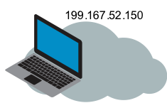
Inbound Traffic from the Internet
Virtual Network 10.0.0.0/16
Untrust
10.0.1.0/24
Trust
10.0.2.0/24
Web
10.0.3.0/24
10.0.1.4
(eth1)
10.0.2.4
(eth2)
10.0.3.4
Azure Public <-> Internal
191.237.87.98 <-- 172.16.1.5
Source: 191.237.87.98
Destination: 199.167.52.150
Source: 199.167.52.150
Destination: 10.0.1.4
Source: 199.167.52.150 150
Destination: 10.0.3.4

Slide 31

Intra-VNET & Inter-VNET Traffic
Azure Route Table
Destination Next Hop
0.0.0.0/0 > 10.0.2.4
Virtual Network 10.0.0.0/16
10.0.3.0/24 > 10.0.2.4
Untrust
10.0.1.0/24
Trust
10.0.2.0/24
Web
10.0.3.0/24
10.0.4.0/24 > 10.0.2.4
10.0.1.4
(eth1)
10.0.2.4
(eth2)
DB
10.0.4.0/24
Azure Public <-> Internal
191.237.87.98 <-- 172.16.1.5
Azure Route Table
Destination Next Hop
0.0.0.0/0 > 10.0.2.4
10.0.3.0/24 > 10.0.2.4
10.0.4.0/24 > 10.0.2.4

Slide 32
Firewall Resiliency with Native Azure Services
Availability Sets
Ensure that a failure or maintenance event in Azure does not affect all the VM-Series firewalls at the same time.
Load Balancers
Distribute traffic across two or more independent firewalls that are members of a common availability set.
Types: Application Gateway, External Load Balancer, Internal Load Balancer

Slide 33

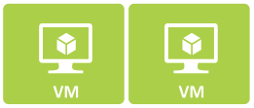

Public Load Balancer
Public Load Balancer
LB Rules allow traffic.
Can do Port Translation
Health Probe
Probe eth1 of the firewalls.
Need to allow Probes on firewall interfaces.
Can have multiple Public IPs.
Public IPs map to multiple IPs on eth1 of the firewalls.
Untrust
10.0.1.0/24
Trust
10.0.2.0/24
Web - 10.0.3.0/24
10.0.1.4
{eth1)
10.0.2.4
{eth2)
Health Probe
(i.e. TCP/22)
10.0.1.4
10.0.1.14
10.0.1.24
PIP-1
PIP-2
PIP-3
Business – 10.0.4.0/24
LB Backend
Pool
10.0.1.5
10.0.1.15
10.0.1.25
10.0.2.5
{eth2)
10.0.1.5
{eth1)
DB - 10.0.3.0/24

Slide 34
Internal Load Balancer
Standard SKU with HA Ports
Uses Firewall Trust NICs as backend pool.
HA Ports sends all traffic to backend pool.
Source NAT is maintained by LB.
Health Probe
Enable Management Profile on Trust NICs within PAN-OS.
Untrust
10.0.1.0/24
Trust
10.0.2.0/24
Web - 10.0.3.0/24
10.0.1.4
{eth2)
10.0.2.4
{eth2)
Health Probe
(i.e. TCP/22)
Business – 10.0.4.0/24
LB Backend
Pool
10.0.1.5
{eth1)
10.0.2.5
{eth2)
10.0.2.100
DB - 10.0.3.0/24

Slide 35
Inbound Traffic Through Public Load Balancer
Virtual Network
10.0.0.0/16
Untrust
10.0.1.0/24
Trust
10.0.2.0/24
Web
10.0.3.0/24
10.0.1.4
(eth1)
10.0.2.4
(eth2)
10.0.3.4
10.0.1.5
(eth1)
10.0.2.5
(eth2)
Source: 199.167.52.150
Destination: 191.237.87.98
Source: 199.167.52.150
Destination: 10.0.1.4
Source: 10.0.2.4
Destination: 10.0.3.4
Source: 191.237.87.98
Destination: 199.167.52.150
Source: 10.0.1.4
Destination: 199.167.52.150
Source: 10.0.3.4
Destination: 10.0.2.4

Slide 36
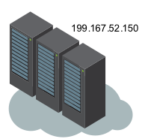

Outbound Traffic Through Internal Load Balancer
Virtual Network
10.0.0.0/16
Untrust
10.0.1.0/24
Trust
10.0.2.0/24
Web
10.0.3.0/24
10.0.1.4
(eth1)
10.0.2.4
(eth2)
10.0.2.100
10.0.3.4
Azure Public <-> Internal
191.237.87.98 <-- 172.16.1.5
10.0.1.5
(eth1)
10.0.2.5
(eth2)
Source: 191.237.87.98
Destination: 199.167.52.150
Source: 10.0.1.4
Destination: 199.167.52.150
Source: 10.0.3.4
Destination: 199.167.52.150
Source: 191.237.87.98
Destination: 199.167.52.150
Source: 199.167.52.150
Destination: 10.0.1.4
Source: 199.167.52.150
Destination: 10.0.3.4

Slide 37
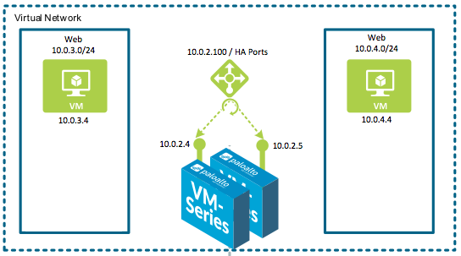
Resiliency for Outbound and Internal Traffic
Azure Route Table
Azure Route Table
Destination Next Hop
0.0.0.0/0 > 10.0.2.100
Destination Next Hop
0.0.0.0/0 > 10.0.2.100
10.0.3.0/24 > 10.0.2.100
10.0.3.0/24 > 10.0.2.100
10.0.4.0/24 > 10.0.2.100
10.0.4.0/24 > 10.0.2.100

Slide 38
We have an issue here…
Azure always sources health probes from an IP address of 168.63.129.16
Internal LB
Since 168.63.129.16 is a public IP, the FW’s default route will send the Internal LB’s health probes to the untrust NIC.
Fix: Create a dedicated VR for the Trust NIC to send probes to 10.0.2.1.
Public LB
We also need to ensure we do not NAT the Probe IP from the Public LB to an internal resource.
Fix: Create a NO-NAT policy for traffic coming from 168.63.129.16
Untrust
10.0.1.0/24
Trust
10.0.2.0/24
Web - 10.0.3.0/24
10.0.1.4
{eth2)
10.0.2.4
{eth2)
Health Probe
(i.e. TCP/22)
Health Probe
(i.e. TCP/22)
Business – 10.0.4.0/24
LB Backend
Pool
10.0.1.5
{eth1)
10.0.2.5
{eth2)
10.0.2.100
DB - 10.0.3.0/24

Slide 39
REFERENCE ARCHITECTURES

Slide 40
Shared Design Model – Inbound

Slide 41
Shared Design Model – Outbound

Slide 42
Shared Design Model – East/West

Slide 43
Shared Design Model – Backhaul

Slide 44
Scaled Design Model - Inbound

Slide 45
Scaled Design Model - Outbound

Slide 46
Scaled Design Model – East/West

Slide 47
Scaled Design Model - Backhaul

Slide 48
TRANSIT DIAGRAM

Slide 49
Lab

Slide 50
Lab Overview

Slide 51








fw-vnet – 192.168.0.0/16
spoke-1-vnet – 192.168.0.0/16
Subnet
untrust – 10.0.1.0/24
Subnet
trust – 10.0.2.0/24
Subnet
default – 192.168.0.0/24
firewall-untrust-pool
firewall-av-set
firewall-trust-pool
web-lb
web-pool
web-av-set
firewall-public-lb
fw1-untrust-nic
10.0.1.4
vm-paloalto-1
fw1-trust-nic
10.0.2.4
192.168.0.100
public-lb-pip
firewall-internal-lb
TCP/80
web-nic
192.168.0.4
web-vm
TCP/22
10.0.2.100
vnet-to-vnet-peering
web-av-set
firewall-av-set
TCP/22
TCP/80
TCP/80
fw2-untrust-nic
10.0.1.5
fw2-trust-nic
10.0.2.5
firewall-av-set
TCP/22
vm-paloalto-2
HA Ports
vnet-1-route-table
Destination Next Hop
0.0.0.0/0 > 10.0.2.100
172.17.0.0/24 > 10.0.2.100
192.168.0.0/24 > 10.0.2.100
Subnet
mgmt – 10.0.0.0/24
fw1-mgmt-pip
fw1-mgmt-nic
10.0.2.4
spoke-2-vnet – 172.17.0.0/16
Subnet
default – 17217.0.0/24
fw2-mgmt-pip
fw2-mgmt-nic
10.0.2.5
vnet-to-vnet-peering
jump-nic
172.17.0.4
jump-vm
vnet-2route-table
Destination Next Hop
0.0.0.0/0 > 10.0.2.100
172.17.0.0/24 > 10.0.2.100
192.168.0.0/24 > 10.0.2.100
Environment Components

Slide 52
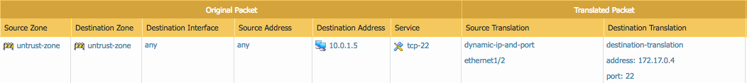
fw-vnet – 192.168.0.0/16
spoke-1-vnet – 192.168.0.0/16
Subnet
untrust – 10.0.1.0/24
Subnet
trust – 10.0.2.0/24
Subnet
default – 192.168.0.0/24
firewall-untrust-pool
firewall-av-set
firewall-trust-pool
web-lb
web-pool
web-av-set
firewall-public-lb
fw1-untrust-nic
10.0.1.4
vm-paloalto-1
fw1-trust-nic
10.0.2.4
192.168.0.100
public-lb-pip
firewall-internal-lb
TCP/80
web-nic
192.168.0.4
web-vm
TCP/22
10.0.2.100
vnet-to-vnet-peering
web-av-set
firewall-av-set
TCP/22
TCP/80
TCP/80
fw2-untrust-nic
10.0.1.5
fw2-trust-nic
10.0.2.5
firewall-av-set
TCP/22
vm-paloalto-2
HA Ports
vnet-1-route-table
Destination Next Hop
0.0.0.0/0 > 10.0.2.100
172.17.0.0/24 > 10.0.2.100
192.168.0.0/24 > 10.0.2.100
Subnet
mgmt – 10.0.0.0/24
fw1-mgmt-pip
fw1-mgmt-nic
10.0.2.4
spoke-2-vnet – 172.17.0.0/16
Subnet
default – 17217.0.0/24
fw2-mgmt-pip
fw2-mgmt-nic
10.0.2.5
vnet-to-vnet-peering
jump-nic
172.17.0.4
jump-vm
vnet-2route-table
Destination Next Hop
0.0.0.0/0 > 10.0.2.100
172.17.0.0/24 > 10.0.2.100
192.168.0.0/24 > 10.0.2.100
Inbound to Jump-VM in Spoke-2-VNET

Slide 53
fw-vnet – 192.168.0.0/16
spoke-1-vnet – 192.168.0.0/16
Subnet
untrust – 10.0.1.0/24
Subnet
trust – 10.0.2.0/24
Subnet
default – 192.168.0.0/24
firewall-untrust-pool
firewall-av-set
firewall-trust-pool
web-lb
web-pool
web-av-set
firewall-public-lb
fw1-untrust-nic
10.0.1.4
vm-paloalto-1
fw1-trust-nic
10.0.2.4
192.168.0.100
public-lb-pip
firewall-internal-lb
TCP/80
web-nic
192.168.0.4
web-vm
TCP/22
10.0.2.100
vnet-to-vnet-peering
web-av-set
firewall-av-set
TCP/22
TCP/80
TCP/80
fw2-untrust-nic
10.0.1.5
fw2-trust-nic
10.0.2.5
firewall-av-set
TCP/22
vm-paloalto-2
HA Ports
vnet-1-route-table
Destination Next Hop
0.0.0.0/0 > 10.0.2.100
172.17.0.0/24 > 10.0.2.100
192.168.0.0/24 > 10.0.2.100
Subnet
mgmt – 10.0.0.0/24
fw1-mgmt-pip
fw1-mgmt-nic
10.0.2.4
spoke-2-vnet – 172.17.0.0/16
Subnet
default – 17217.0.0/24
fw2-mgmt-pip
fw2-mgmt-nic
10.0.2.5
vnet-to-vnet-peering
jump-nic
172.17.0.4
jump-vm
vnet-2route-table
Destination Next Hop
0.0.0.0/0 > 10.0.2.100
172.17.0.0/24 > 10.0.2.100
192.168.0.0/24 > 10.0.2.100
Inbound to Web LB in Spoke-1-VNET

Slide 54
fw-vnet – 192.168.0.0/16
spoke-1-vnet – 192.168.0.0/16
Subnet
untrust – 10.0.1.0/24
Subnet
trust – 10.0.2.0/24
Subnet
default – 192.168.0.0/24
firewall-untrust-pool
firewall-av-set
firewall-trust-pool
web-lb
web-pool
web-av-set
firewall-public-lb
fw1-untrust-nic
10.0.1.4
vm-paloalto-1
fw1-trust-nic
10.0.2.4
192.168.0.100
public-lb-pip
firewall-internal-lb
TCP/80
web-nic
192.168.0.4
web-vm
TCP/22
10.0.2.100
vnet-to-vnet-peering
web-av-set
firewall-av-set
TCP/22
TCP/80
TCP/80
fw2-untrust-nic
10.0.1.5
fw2-trust-nic
10.0.2.5
firewall-av-set
TCP/22
vm-paloalto-2
HA Ports
vnet-1-route-table
Destination Next Hop
0.0.0.0/0 > 10.0.2.100
172.17.0.0/24 > 10.0.2.100
192.168.0.0/24 > 10.0.2.100
Subnet
mgmt – 10.0.0.0/24
fw1-mgmt-pip
fw1-mgmt-nic
10.0.2.4
spoke-2-vnet – 172.17.0.0/16
Subnet
default – 17217.0.0/24
fw2-mgmt-pip
fw2-mgmt-nic
10.0.2.5
vnet-to-vnet-peering
jump-nic
172.17.0.4
jump-vm
vnet-2route-table
Destination Next Hop
0.0.0.0/0 > 10.0.2.100
172.17.0.0/24 > 10.0.2.100
192.168.0.0/24 > 10.0.2.100
Outbound from Spoke-2-VNET

Slide 55
fw-vnet – 192.168.0.0/16
spoke-1-vnet – 192.168.0.0/16
Subnet
untrust – 10.0.1.0/24
Subnet
trust – 10.0.2.0/24
Subnet
default – 192.168.0.0/24
firewall-untrust-pool
firewall-av-set
firewall-trust-pool
web-lb
web-pool
web-av-set
firewall-public-lb
fw1-untrust-nic
10.0.1.4
vm-paloalto-1
fw1-trust-nic
10.0.2.4
192.168.0.100
public-lb-pip
firewall-internal-lb
TCP/80
web-nic
192.168.0.4
web-vm
TCP/22
10.0.2.100
vnet-to-vnet-peering
web-av-set
firewall-av-set
TCP/22
TCP/80
TCP/80
fw2-untrust-nic
10.0.1.5
fw2-trust-nic
10.0.2.5
firewall-av-set
TCP/22
vm-paloalto-2
HA Ports
vnet-1-route-table
Destination Next Hop
0.0.0.0/0 > 10.0.2.100
172.17.0.0/24 > 10.0.2.100
192.168.0.0/24 > 10.0.2.100
Subnet
mgmt – 10.0.0.0/24
fw1-mgmt-pip
fw1-mgmt-nic
10.0.2.4
spoke-2-vnet – 172.17.0.0/16
Subnet
default – 17217.0.0/24
fw2-mgmt-pip
fw2-mgmt-nic
10.0.2.5
vnet-to-vnet-peering
jump-nic
172.17.0.4
jump-vm
vnet-2route-table
Destination Next Hop
0.0.0.0/0 > 10.0.2.100
172.17.0.0/24 > 10.0.2.100
192.168.0.0/24 > 10.0.2.100
East-West between Spoke-1-VNET & Spoke-2-VNET

Slide 56
Deploy the Template

Slide 57
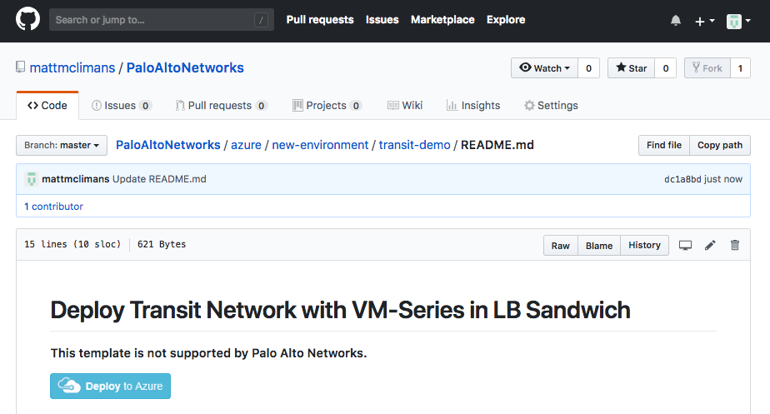
Step A1. Launch the Template
Go to: https://github.com/mattmclimans/PaloAltoNetworks/tree/master/azure/new-environment/transit-demo
Click “Deploy to Azure”

Slide 58
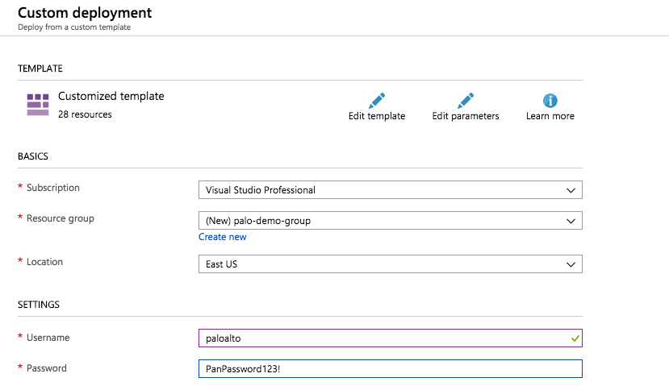
Step A2. Create New Resource Group
Create a new Resource Group.
Select East US for the region.

Slide 59
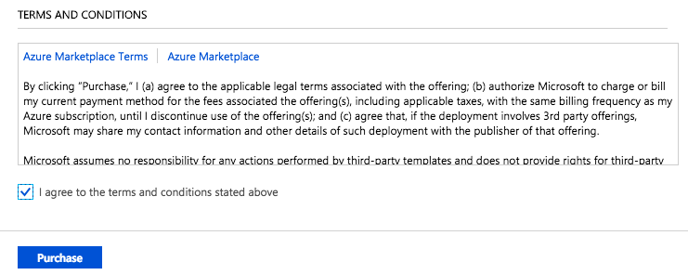
Step A3. Agree to Terms & Conditions
Scroll to bottom
Accept Licensing Terms and Conditions
Click Purchase
DO NOT CHANGE ANY OTHER FIELDS.

Slide 60
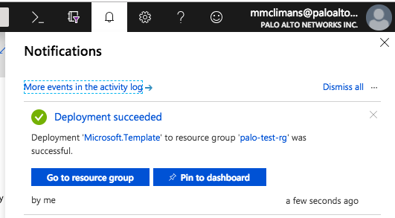
Step A4. Wait for deployment to complete…
Deployment takes ~10 Minutes to complete.
Once the template finishes, the bell in the top right corner will say “Deployment Succeeded”

Slide 61
License the Firewall

Slide 62
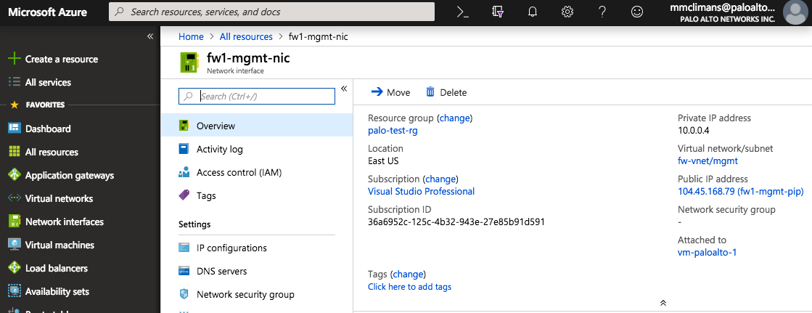
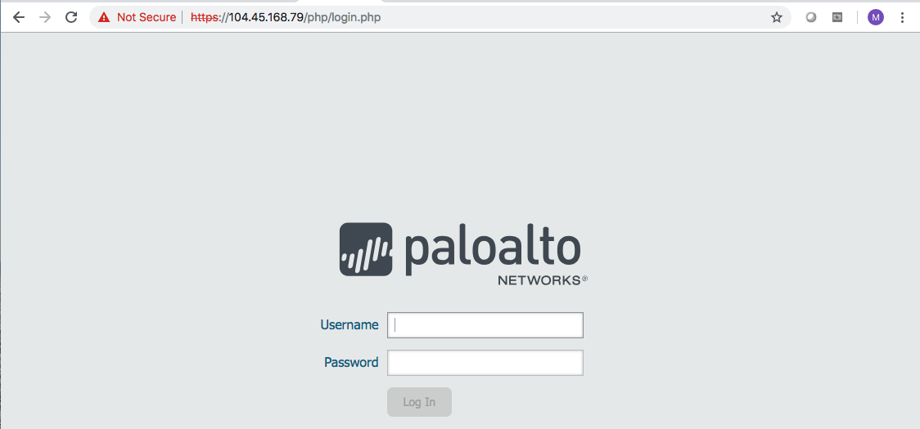
Step B1. Find FW-1 Management IP.
Go to All Resources→fw1-mgmt-pip
Copy the Public IP Address to your clipboard.
Paste the IP in a browser preceded by https://
Accept certificate warning and enter the credentials:
Username: paloalto
Password: PanPassword123!
paloalto
PanPassword123!

Slide 63
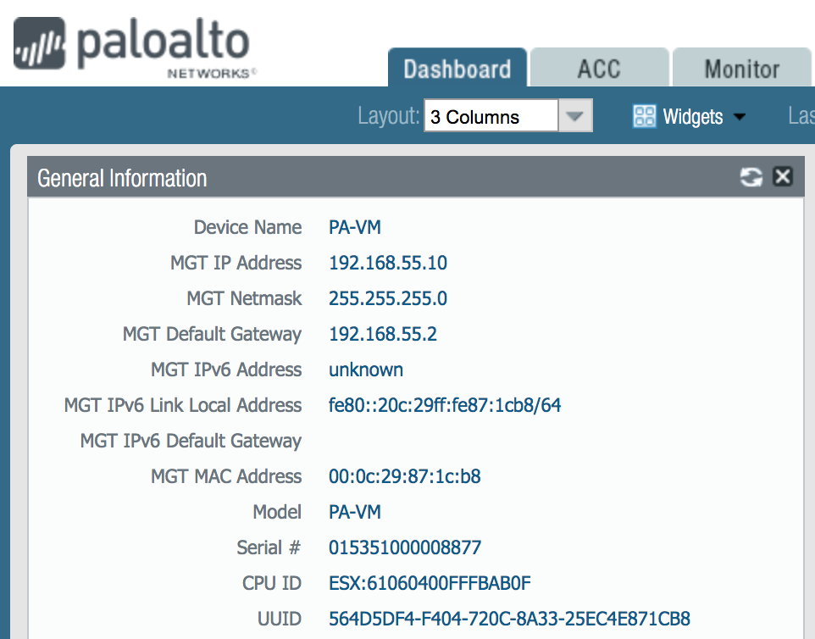
Step B2. License the VM-Series
Copy CPU ID & UUID from firewall dashboard.
https://support.paloaltonetworks.com
Username: Microsoft Email
Password: pan4MS!55
Create Security Answers

Slide 64
Step B2. License the VM-Series
Copy CPU ID & UUID from firewall dashboard.
https://support.paloaltonetworks.com
Username: Microsoft Email
Password: pan4MS!55
Create Security Answers

Slide 65
Configure Untrust and Trust NICs

Slide 66
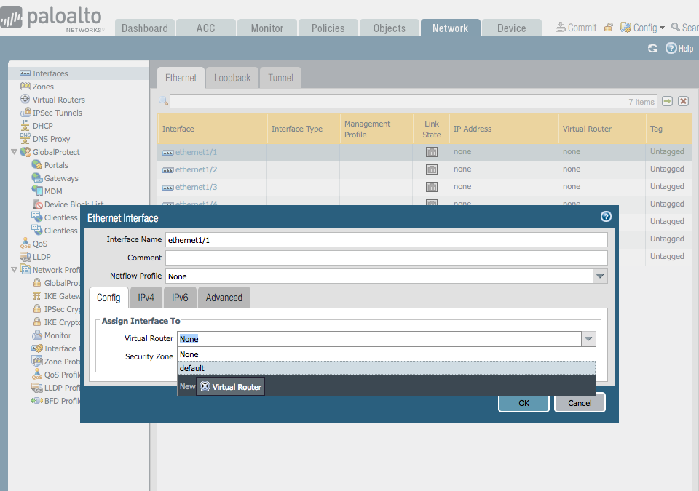
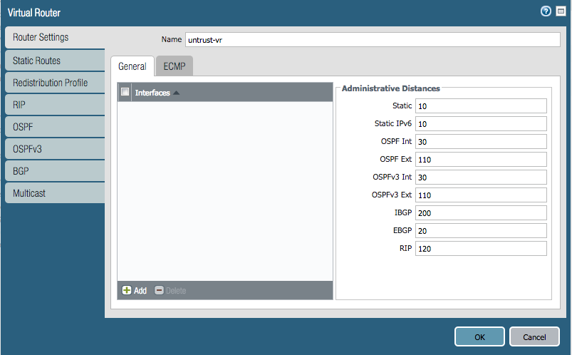
Step B3. Assign Virtual Router to Ethernet1/1

Slide 67
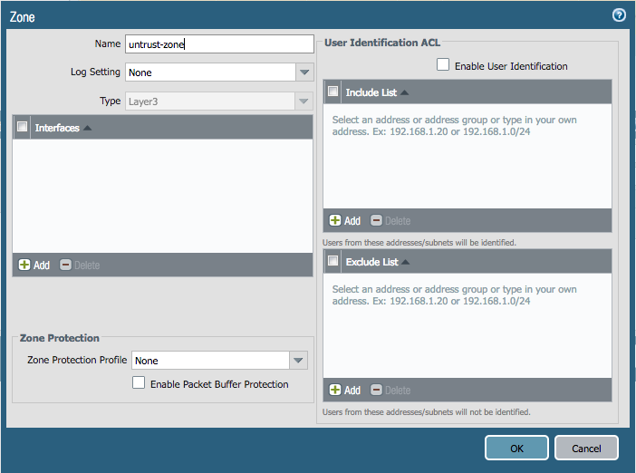
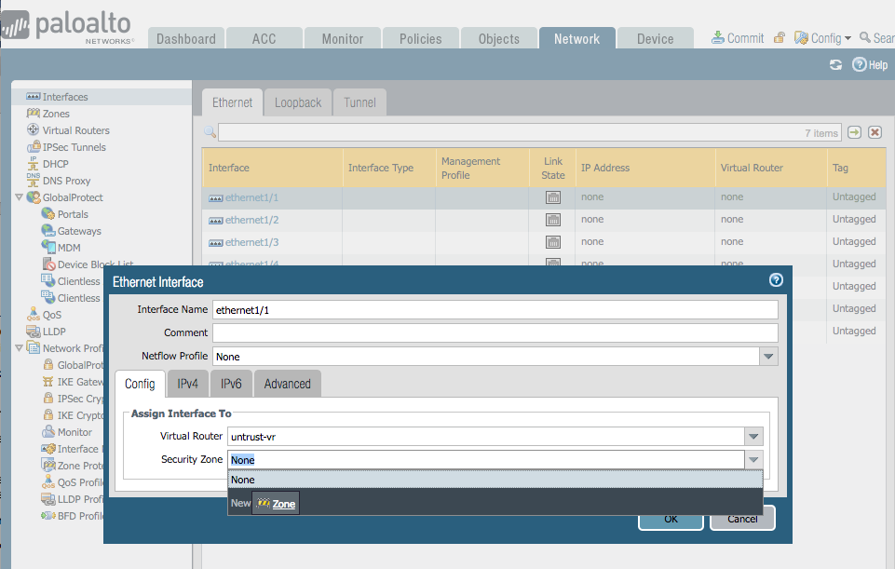
Step B4. Assign Zone to Ethernet1/1

Slide 68
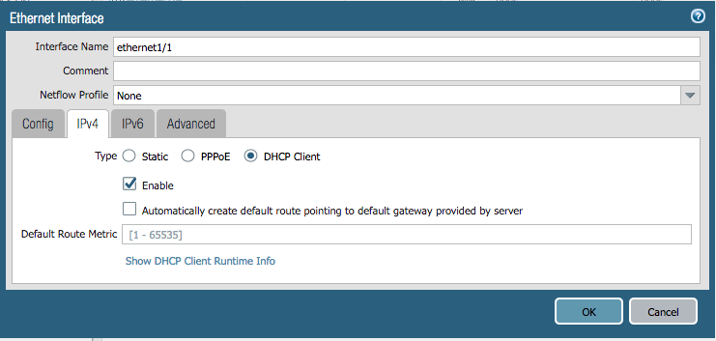
Step B5. Set Ethernet1/1 to DHCP
While still inside ethernet1/1, click IPv4 Tab.
Check DHCP Client (we will pull whatever IP Address Azure is giving us).
Uncheck “Automatically create default route pointing to default gateway provided by server.”

Slide 69
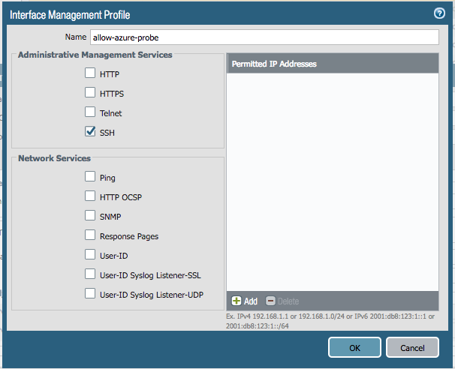
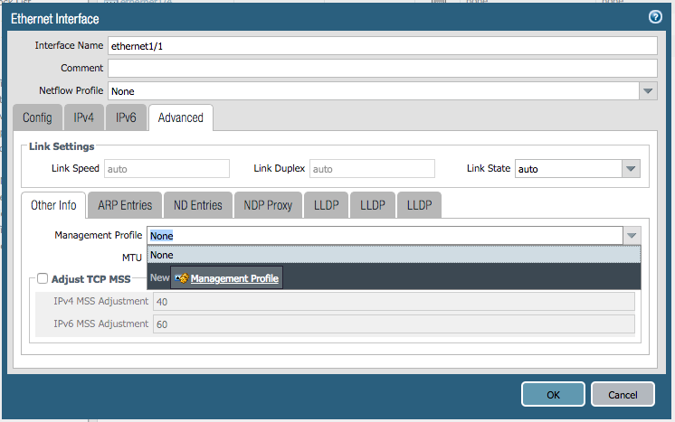
Step B6. Assign Management Profile to Ethernet1/1
While still inside ethernet1/1, click Advanced Tab.
Click the Management Profile dropdown and select New Management Profile.
Enable SSH, click OK

Slide 70
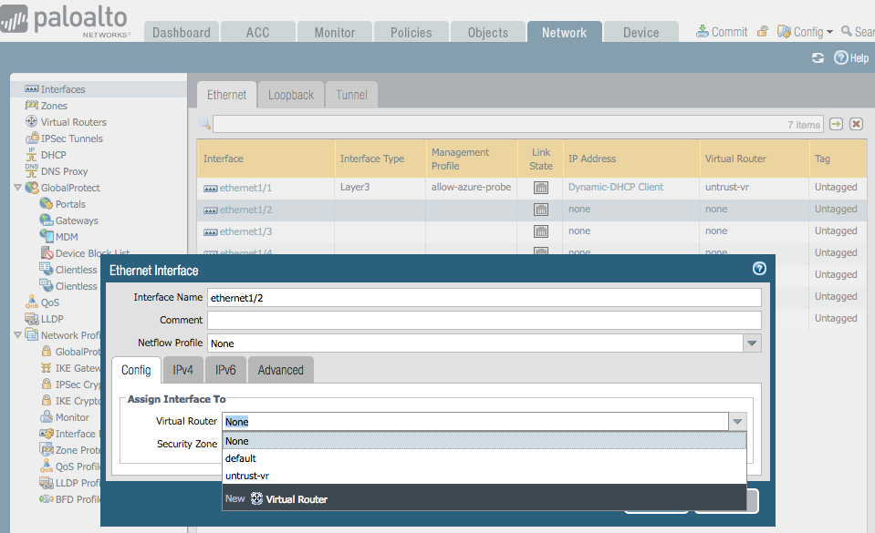
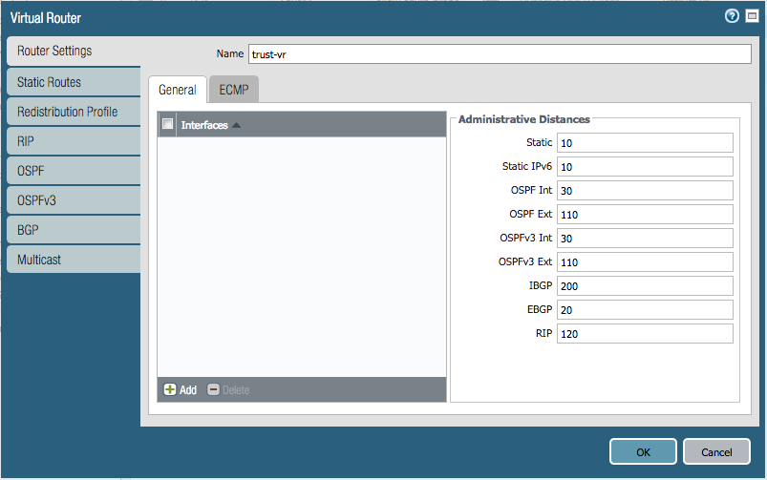
Step B7. Assign Virtual Router to Ethernet1/2

Slide 71
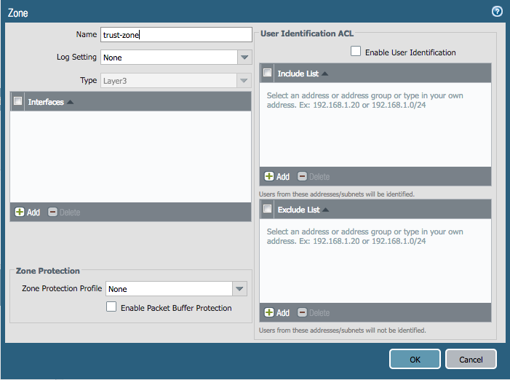
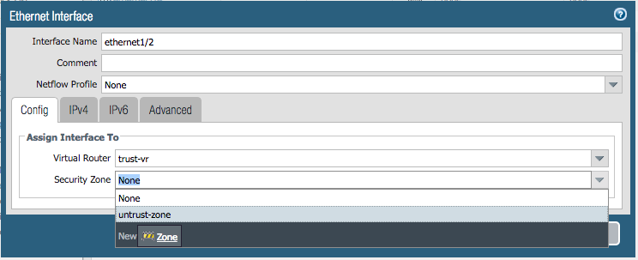
Step B8. Assign Zone to Ethernet1/2

Slide 72
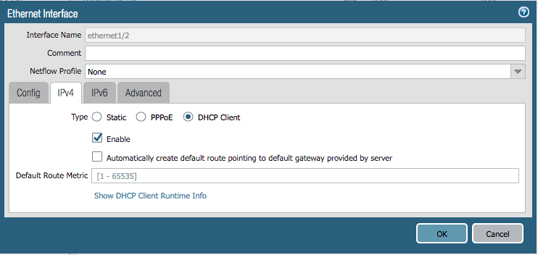
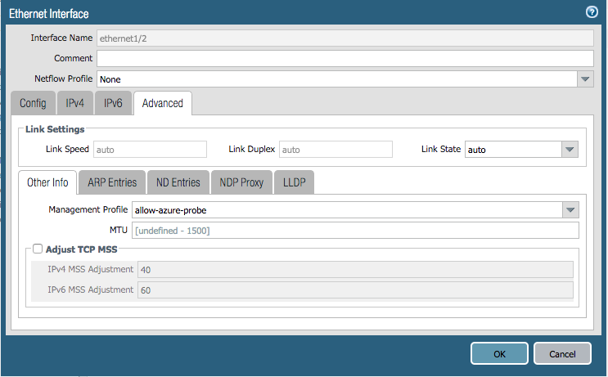
Step B9. Find FW-1 Management IP.

Slide 73
Configure Routing on Virtual Routers

Slide 74
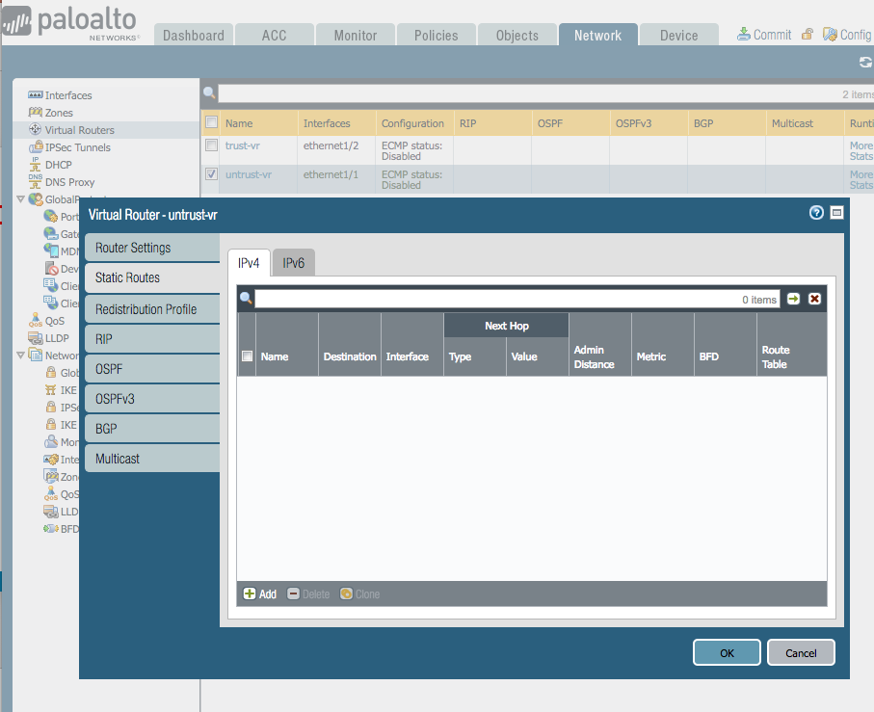
Step C1. Go to Untrust-VR
Go to:
Network →
Virtual Routers →
untrust-vr →
Static Routes → Add

Slide 75
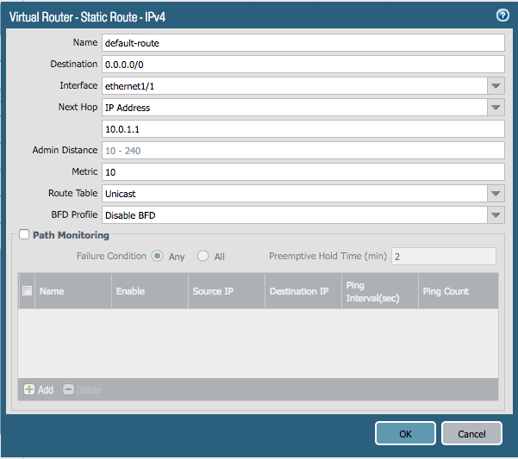
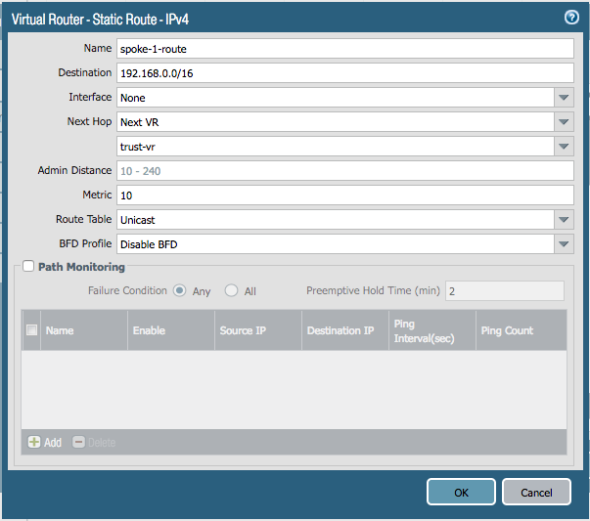
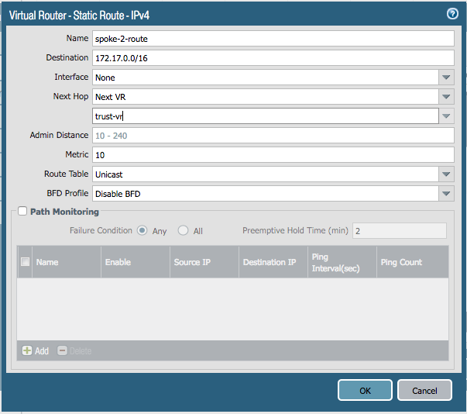
Step C2. Create 3 Routes in Untrust-VR

Slide 76
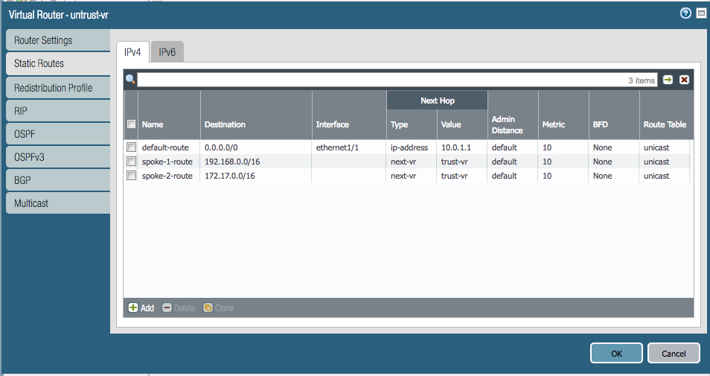
Untrust-VR Route Summary
You should have 3 routes like the image to the left.

Slide 77
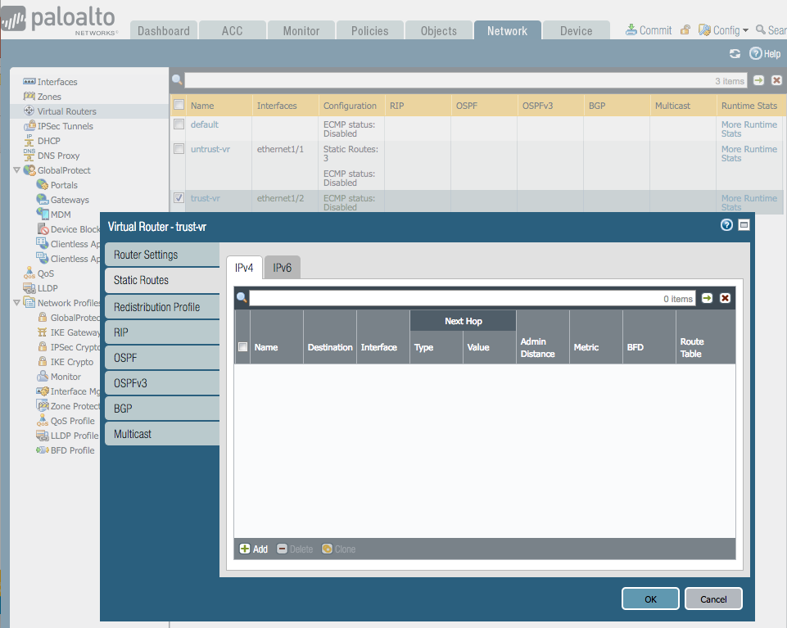
Step C3. Go to Trust-VR
Go to:
Network →
Virtual Routers →
trust-vr →
Static Routes → Add

Slide 78
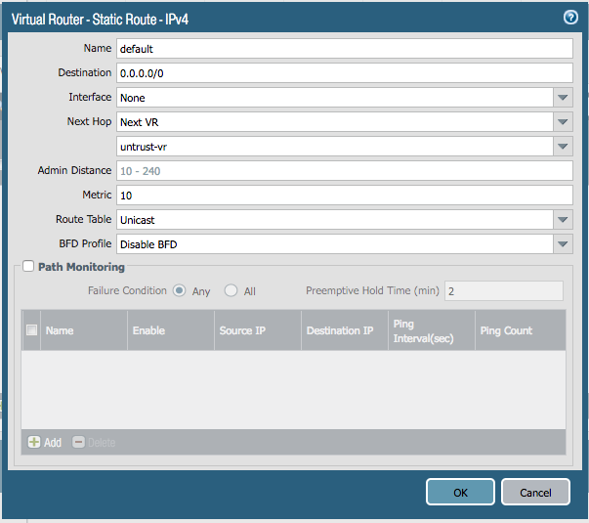
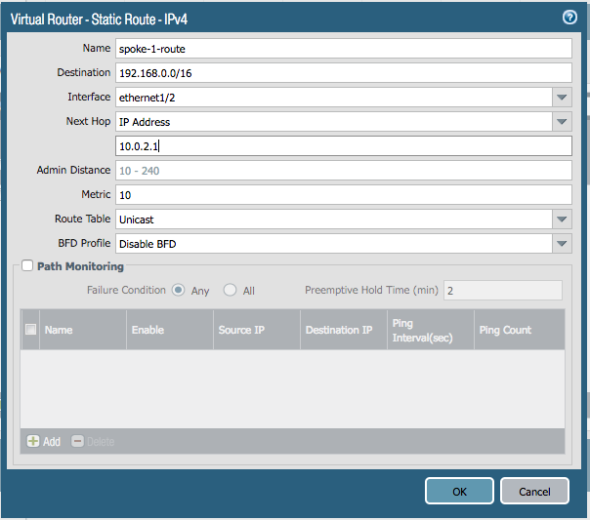
Step C4 (pt 1). Create Routes on Trust-VR

Slide 79
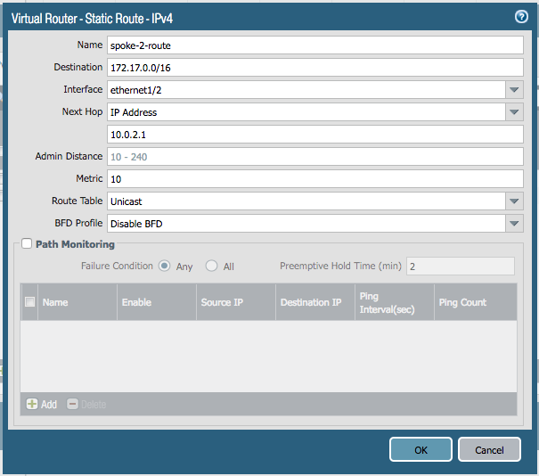
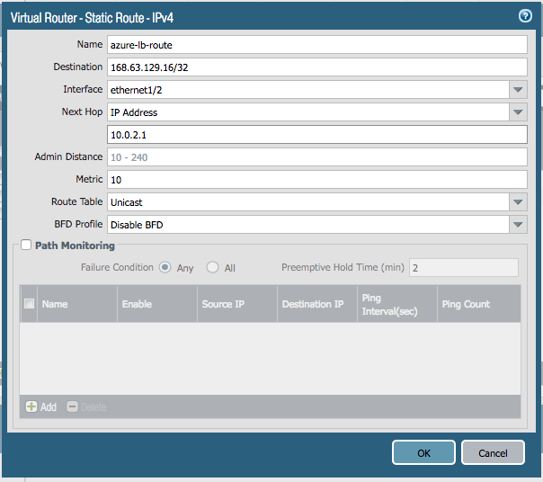
Step C4 (pt 2). Create Routes on Trust-VR

Slide 80
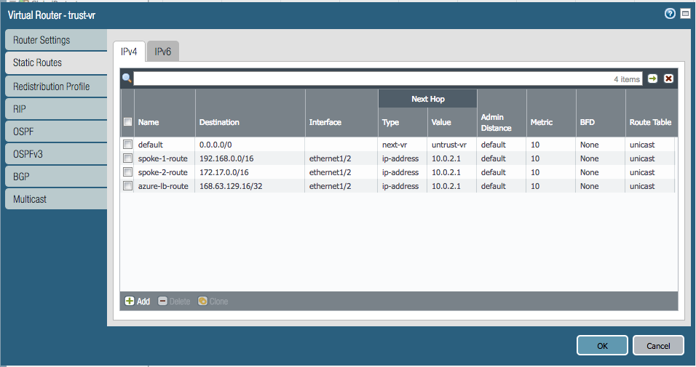
Trust-VR Route Summary
You should have 4 routes like the image to the left.

Slide 81
Configure NAT Policies

Slide 82
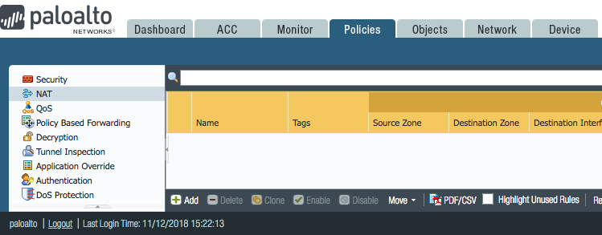
NAT Policy Overview
We need to create 4 NAT Policies.
No-NAT on Azure Probe
DNAT to Web LB
DNAT to Jump VM
SNAT for Internet

Slide 83
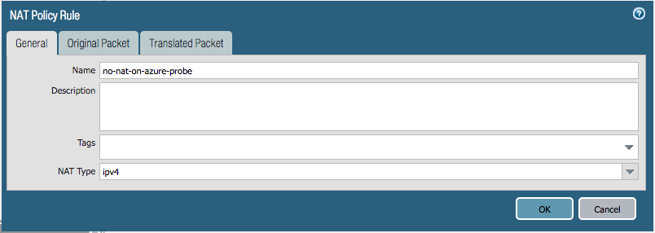
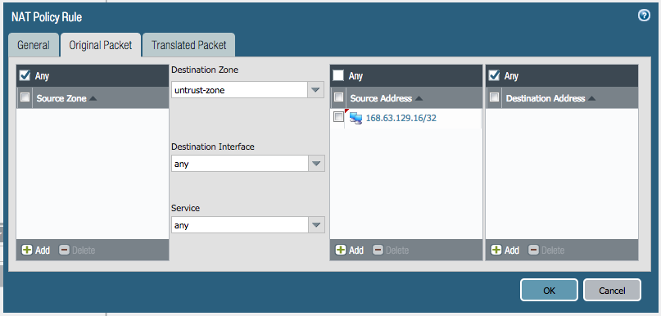
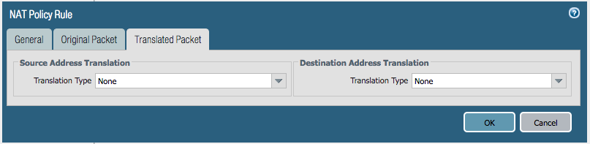
Step D1. Create No-NAT Policy for Azure Probe

Slide 84
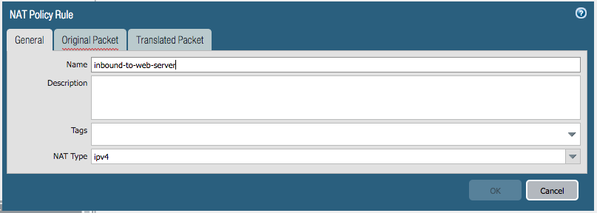
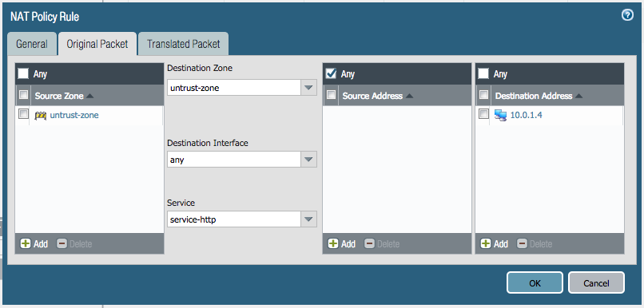
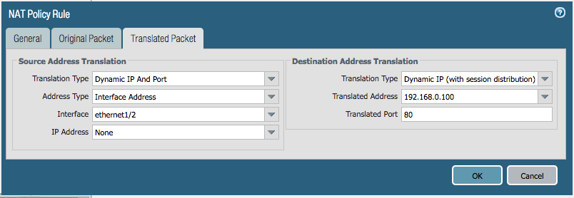
Step D2. Create DNAT Policy to Web-LB

Slide 85

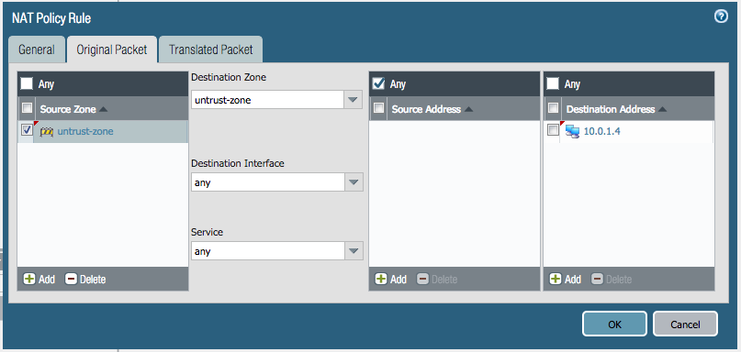

Step D3. Create DNAT Policy to Jump VM

Slide 86

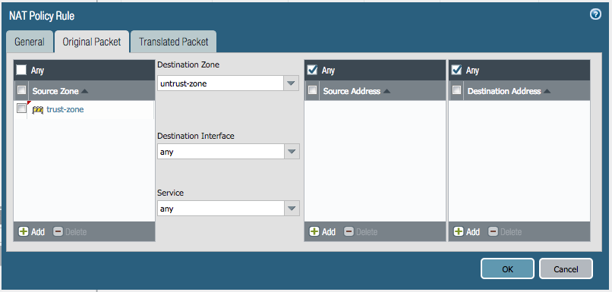
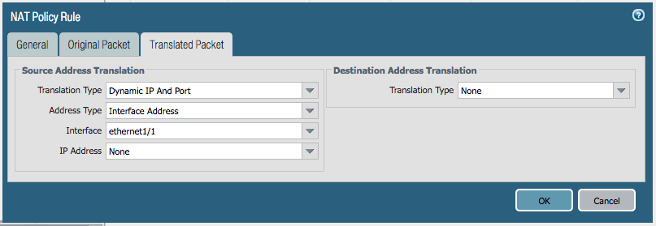
Step D4. Create SNAT Policy for Internet

Slide 87
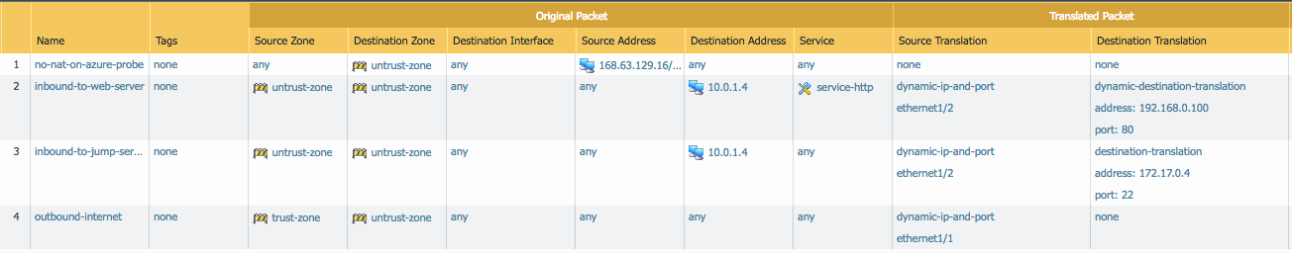
NAT Policy Summary
Once completed, your 4 NAT policies should like the image below.

Slide 88
Configure Security Policies
&
Commit Changes

Slide 89

Step E1. Create a New Security Policy
We need to create 1 Security Policy to Allow-All Traffic.
THIS IS TEMPORARY FOR TESTING PURPOSES ONLY.

Slide 90



Step E2. Configure the Security Policy

Slide 91
Security Policy Summary
Once completed, your test Security Policy should like the image below

Slide 92

Step E3. Commit all our Changes
Commit all the changes we made to the firewall by clicking Commit in the top right corner and selecting Commit again.

Slide 93
Test the Deployment

Slide 94

Step F1. Find Public LB Public IP
Go to the Azure Portal → All Resources → firewall-public-lb
Copy the public IP associated with the Public Load Balancer.

Slide 95


Step F2. SSH into VM and test Traffic Flows.
Step 1. Open an SSH session using the hostname, username, and password below.
Hostname: Your-Public-LB-IP
Username: paloalto
Password: PanPassword123!
Step 2. Try pinging out to the internet
Step 3. Try pinging to the other Spoke VNET

Slide 96

Step F3. SSH into Web VM and install Apache
Step 1. While in the jump-vm, SSH to the Web-VM in Spoke-1-VNET
Step 2. Install apache by entering sudo apt-get install apache2 -y
Step 3. Paste the Public Load Balancers IP into your browser (i.e. http://<your-ip-here>)
and a Apache page should open.

Slide 97

Step F4. Filter Firewall Traffic Logs for your tested Traffic
Go to the firewall. Click Monitor → Traffic.
Type the filter (addr in 192.168.0.4)to view all traffic associated with your web server.

Slide 98
Thank you!

